Slide 1
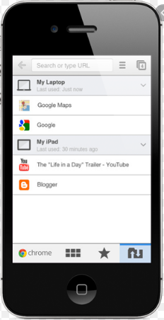

Introduction to Web Service Application Layers
Presentation Layer
Service Layer
Data Layer
UsersRESTController
UsersService
UsersRepository
UserModelREST
UserDTO
UserDTO
UserEnitity

Slide 2
Introduction to Web Service Application Layers
E:\udemy\[FreeTutorials.Us] Udemy - RESTful Web Services, Java, Spring Boot, Spring MVC and JPA\1. Introduction

